Slide 1
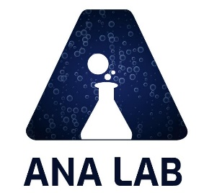
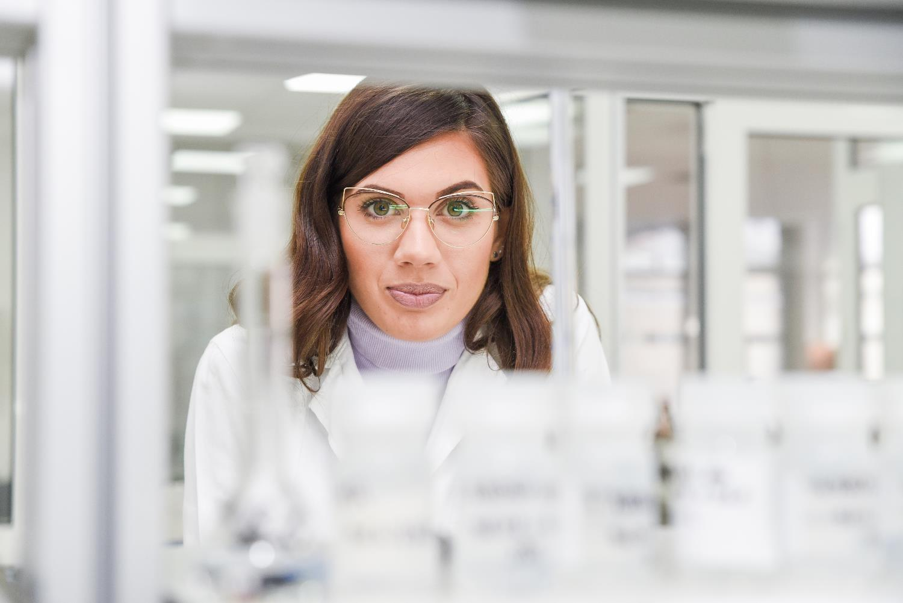
ANA LAB – YOUR PARTNER IN ANALYSIS OF FOOD AND BEVERAGES

Slide 2
EIM-IRMSTM
New Frontiers In Food Authenticity And Beyond
https://www.ana-lab.rs/en/home/ ; e-mail: office@ana-lab.rs
ANA LAB DOO Proprietary Information,
Powered by ANA LAB DOO Pančevo, Republic of Serbia
www.ana-lab.rs/en/home/

Slide 3

WINE MARKET
The global wine market is projected to grow from US$ 340.23 billion in 2021 to $456.76 billion in 2028 at a CAGR of 4.30% in forecast period, 2021-2028
  US is the second largest producer and importer or wine behind the EU.
  US has become the largest consumable wine market in the world.
  New world countries, especially the United States, Australia, and Chile are becoming a serious competition to the EU in wine production.
  Large amount of wine is produced and traded without understanding authenticity and practices used in production.
  Quality and authenticity of products have become critical concerns.
  High quality wines represent about 40% of the total E.U. market production, and less than 3% of US production.
ANA LAB DOO Proprietary Information,
Powered by ANA LAB DOO Pančevo, Republic of Serbia
www.ana-lab.rs/en/home/

Slide 4
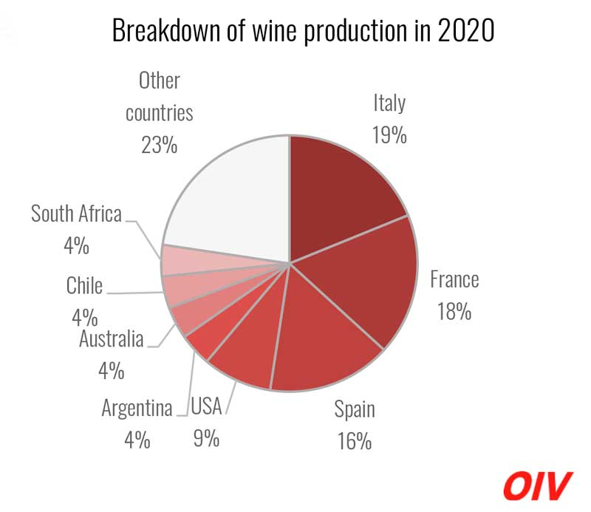
WINE PRODUCTION SIZE
ANA LAB DOO Proprietary Information,
Powered by ANA LAB DOO Pančevo, Republic of Serbia
www.ana-lab.rs/en/home/

Slide 5
TECHNOLOGY
ANA LAB DOO Proprietary Information,
Powered by ANA LAB DOO Pančevo, Republic of Serbia
www.ana-lab.rs/en/home/

Slide 6
PRACTICES IN WINE MAKING
  Wine making practices:
    Chaptalization – addition of sugar to grape must to enhance fermentation and raise alcohol level just before of during fermentation
    Amelioration – is the addition of either water or pure dry sugar, or a combination of water and sugar to adjust the acid level to juice or natural wine before, during, or after fermentation.
Addition of water in fruit juice
Even though addition of water is legal in production of fruit juice, it has to be declared as fruit juice made from concentrate.
ANA LAB DOO Proprietary Information,
Powered by ANA LAB DOO Pančevo, Republic of Serbia
www.ana-lab.rs/en/home/

Slide 7
WINE MAKING GUIDELINES
  EU
    Addition of sugar can be done only in certain regions and under strict guidelines to the amount of sugar and the percentage of alcohol gained from it.
    These production practices are strictly forbidden in production of quality wines.
  US
    Chaptalization and Amelioration are accepted practices in all states except California where both of these practices are prohibited (over 90% of total US wine production is done in California).
    These practices are allowed only under certain conditions – if grape acidity, amount of sugar in grape is insufficient for fermentation to commence.
ANA LAB DOO Proprietary Information,
Powered by ANA LAB DOO Pančevo, Republic of Serbia
www.ana-lab.rs/en/home/

Slide 8
ANALYTICAL PRINCIPLES
  Isotopic methods are very powerful analytical tool which are used to check the authenticity of wines and to detect any illegal production practices.
  By measuring the relative ratios of stable isotopes like Carbon (¹³C/¹²C), Oxygen (¹⁸O/¹⁶O) and Hydrogen (D/H) useful information about wine production can be obtained.
  Analytical instruments and techniques which are currently used for isotopic analysis are IRMS (Isotope Ratio Mass Spectrometry) and the official OIV NMR method (Site Natural Isotopic Fractionation – Nuclear Magnetic Resonance NMR).
ANA LAB DOO Proprietary Information,
Powered by ANA LAB DOO Pančevo, Republic of Serbia
www.ana-lab.rs/en/home/

Slide 9
WHAT IS MEASURED?
  By measuring the relative ratio of carbon stable isotopes (¹³C/¹²C) in wine ethanol, information on sugar additions which originate from corn or sugar cane (IRMS) can be detected (standard procedure).
  By measuring the relative ratio of oxygen stable isotopes (¹⁸O/¹⁶O) in wine, information on water addition (IRMS) is determined (standard procedure).
  By measuring the relative ratio of non-exchangeable hydrogen stable isotopes (D/H) on carbon atoms in wine ethanol samples, information on sugar or ethanol addition which originates from beet sugar, wheat, barley, etc. is obtained. (patented methodology).
ANA LAB DOO Proprietary Information,
Powered by ANA LAB DOO Pančevo, Republic of Serbia
www.ana-lab.rs/en/home/

Slide 10
OVERVIEW OF THE PRESENT QUALITY CONTROL OF WINE
ANA LAB DOO Proprietary Information,
Powered by ANA LAB DOO Pančevo, Republic of Serbia
www.ana-lab.rs/en/home/

Slide 11
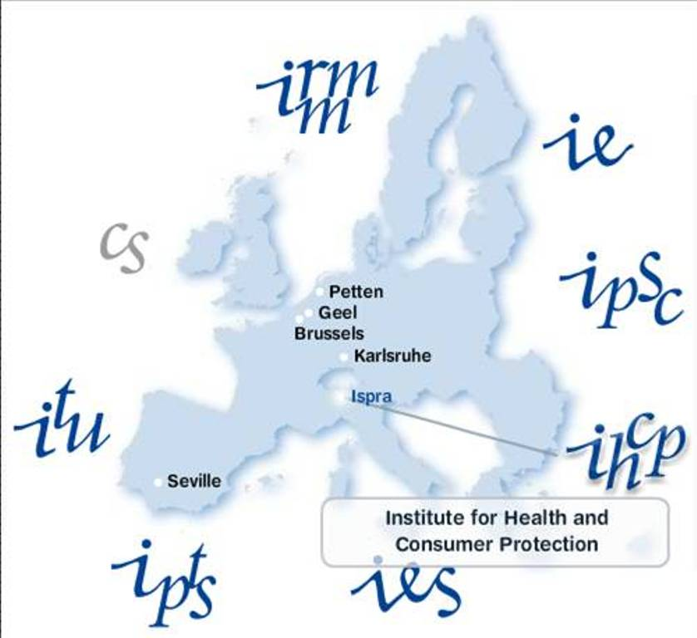
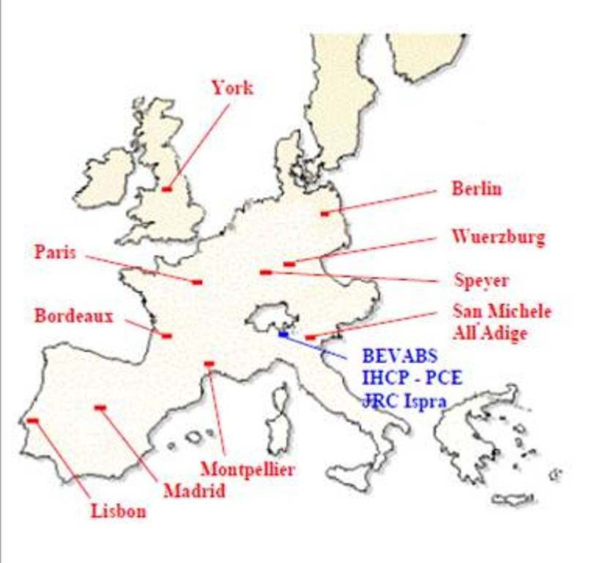
OVERVIEW OF THE PRESENT WINE QUALITY CONTROL ACTIONS
Based on the official OIV NMR method methodology, the European Commission has founded BEVABS previously located at IHCP (member institute of JRC), in Italy (Ispra), and a network of National Referent Laboratories throughout the E.U. to prepare European isotopic wine databanks, used to guarantee the geographical origin and authenticity of all European wines with a designated origin.
Today this cener is located in Geel, Belgium
ANA LAB DOO Proprietary Information,
Powered by ANA LAB DOO Pančevo, Republic of Serbia
www.ana-lab.rs/en/home/

Slide 12
DIFFERENTIATION OF ETHANOL’S BOTANICAL ORIGIN
Graphical representation of the official OIV NMR method
(D/H)_{I} vs. IRMS δ¹³C values for ethanol with different botanical origin
  These are referent zones for ethanol of different botanical origins.
  (D/H)_{I} values gained from the official OIV NMR method, show that referent zones differ from each other by only 10 ppm based on TMU standard (Tetramethyl - urea).
  This is the reason why official OIV NMR method requires large sample database for botanical verification.
  Without specific sample database conclusions are very subjective and quantitative analysis impossible.
ANA LAB DOO Proprietary Information,
Powered by ANA LAB DOO Pančevo, Republic of Serbia
www.ana-lab.rs/en/home/

Slide 13
INDUSTRY COMMENTS ABOUT OFFICIAL OIV NMR METHOD
As stated by Claude Guillou, the Team Leader of BEVABS, and his associates Segebarth Nicolas, Alonso-Salces Rosa-Maria and Skordi Eleni from IHCP (Institute for Health and Consumer Protection) in the Scientific and Technical Report which was published under the title “Analysis and Characterization of Alcoholic Products” in JRC (Joint Research Center) Bulletin (2008):
“…A sample is considered problematic if its ethanol (D/H)_{I} value falls out of the natural range. In the case of wine for instance, values under 99 ppm to 105 ppm are suspicious. If average values for (D/H)_{I} are considered, then an evaluation of the detection limit for ethanol addition can be made for the different possible ethanol sources (Table 1). This is only indicative since with this approach the addition of beet ethanol to a wine with high (D/H)_{I} value (105 ppm) would be detected only if its proportion is superior to 50%! If the geographic origin of the wine is known, then the natural (D/H)_{I} range can be reduced and the detection limit refined: it is case-to-case work necessitating supplementary information on the wine (grape growing region, for instance). With this method, addition to wine of ethanol from distilled wine or fruit wines (apples, etc.) cannot be detected (all fruit alcohols have similar D/H ranges). If the ethanol added comes from grain, it will be detected only if its proportion is higher than 70%.”
ANA LAB DOO Proprietary Information,
Powered by ANA LAB DOO Pančevo, Republic of Serbia
www.ana-lab.rs/en/home/

Slide 14
THE OFFICIAL OIV NMR METHOD FEEDBACK
Ethanol source | (D/H)_{I} /ppm Natural range | Minimum proportion of added ethanol in wine (102 ppm) for addition detection | (D/H)_{I} /ppm in wine + ethanol addition
Grape Beet sugar Cane sugar Grain Potato Fruits Synthetic alcohol | 99-105 91-93 108-110 96-99 93-95 97-104 123-124 | - 35% 50% 70% 40% 100% 15% | - 98.5 105.5 98.85 98.8 100.5 (n.d.!) 105.2
Table 1: Natural (D/H)_{I} range for various ethanol source and calculation of the detection limit for the addition to wine of ethanol for the different ethanol sources (considering average values). n.d. = not detectable
Source: The Scientific and Technical Report which was published under the title “Analysis and Characterization of Alcoholic Products” by Claude Guillou, Segebarth Nicolas, Alonso-Salces Rosa-Maria and Skordi Eleni from IHCP (Institute for Health and Consumer Protection published in JRC (Joint Research Center) Bulletin (2008).
ANA LAB DOO Proprietary Information,
Powered by ANA LAB DOO Pančevo, Republic of Serbia
www.ana-lab.rs/en/home/

Slide 15
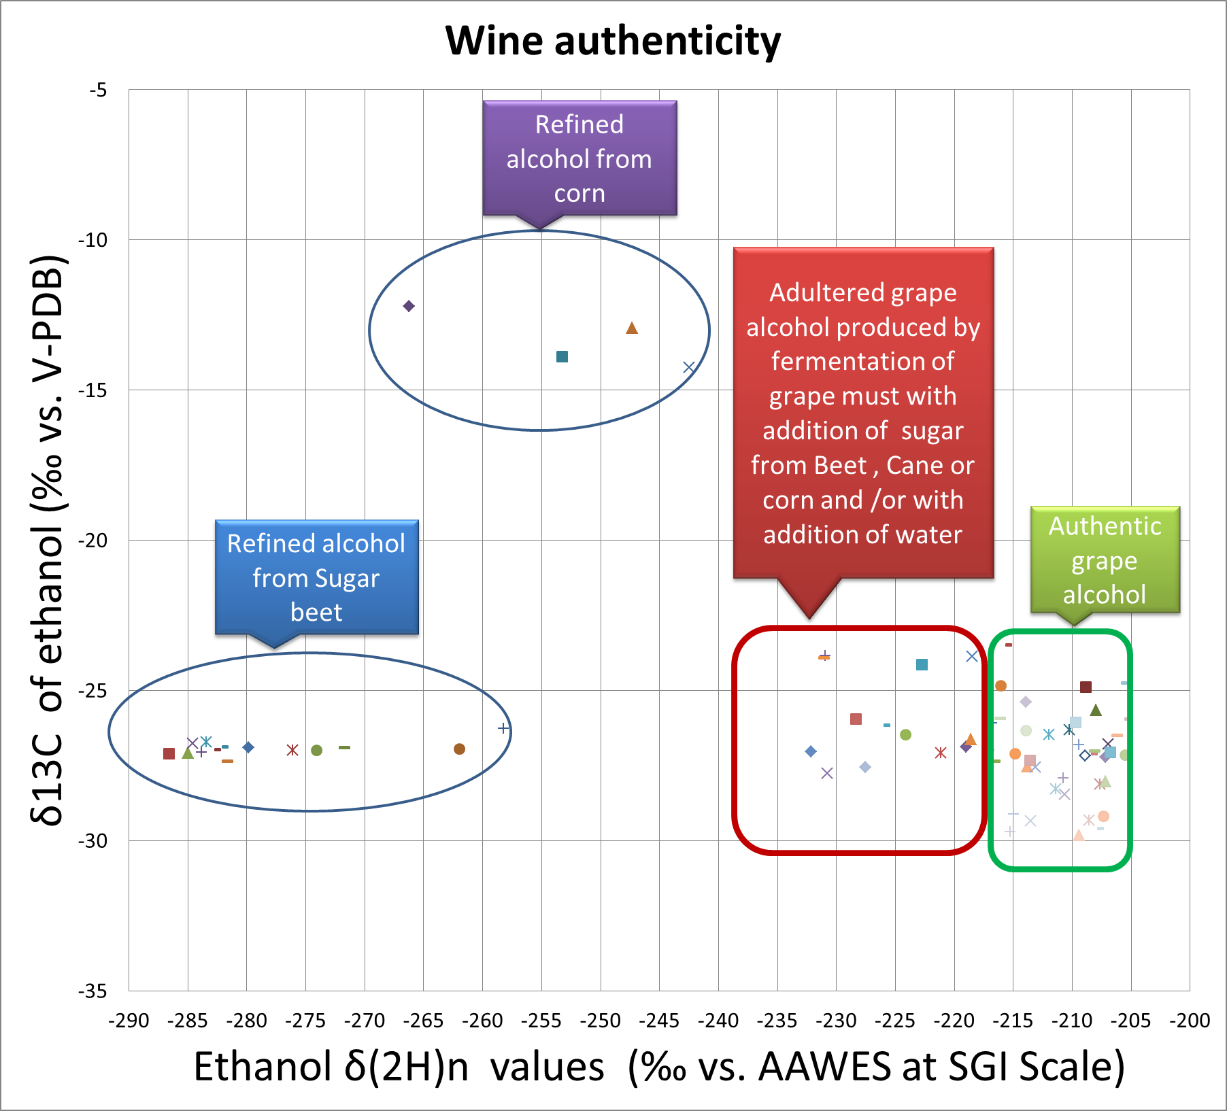
EIM-IRMSTM - DETECTION OF ADULTERATION IN KNOWN AND UNKNOWN WINE SAMPLES
The EIM-IRMSTM method shown here expresses a much larger free space between clusters for beet sugar and grape.
The difference between mean ethanol δDn values for grape and beet sugar is ~70‰ vs. AAWES, and the distance between clusters is ~40‰ vs. AAWES.
This allows detection of adulteration in known and unknown wine samples.
ANA LAB DOO Proprietary Information,
Powered by ANA LAB DOO Pančevo, Republic of Serbia
www.ana-lab.rs/en/home/

Slide 16
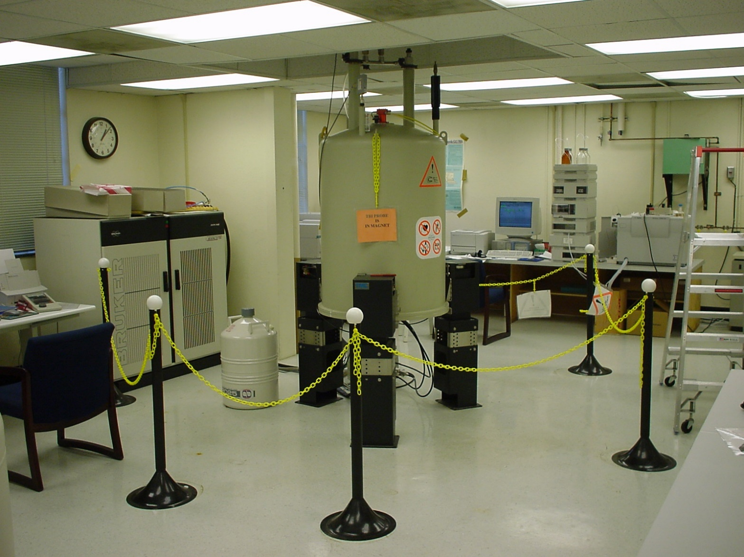
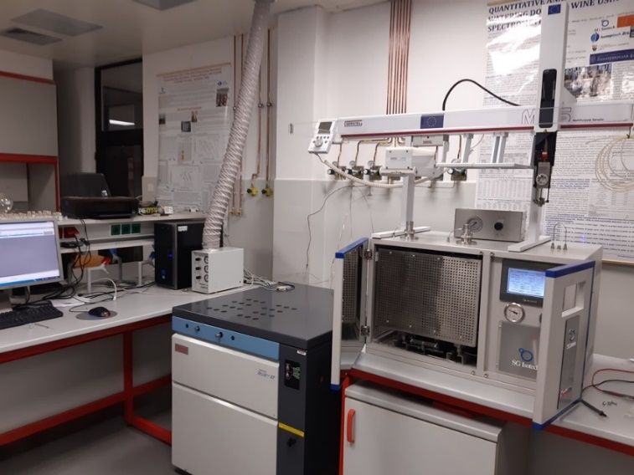
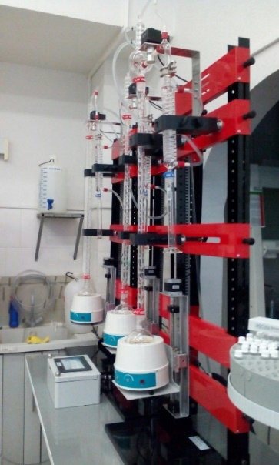
NMR VS. EIM-IRMSTM SETUP
ANA LAB DOO Proprietary Information,
Powered by ANA LAB DOO Pančevo, Republic of Serbia
www.ana-lab.rs/en/home/

Slide 17
ADVANTAGES AND DISADVANTAGES OF TECHNIQUES USED IN ISOTOPIC ANALYSIS OF WINE
  EIM-IRMSTM
  Features:
    Determination of botanical origin by measuring addition of water and sugar to known and unknown samples
    Determination of Geographical Origin
    Verification of authenticity of wine and strong spirits
  Advantages
    Ability to uncover counterfeit products
    Ability to report illegal production practices in unknown wines
    More accurate analysis
    Low cost of analysis
    Short time of analysis (4 minutes per sample)
    Approx. 50 samples can be analyzed day
    Patented and published method
    Continious flow method
    Over 10 new applications for authenticity of honey, strong spirits, fruit juices, milk, wine, fruit concentrates, etc.
  Official OIV NMR method
Features:
    Only used for measuring of (D/H)_{I} and (D/H)_{II} in wine ethanol samples to detect sugar addition which originates from sugar beet
Advantages:
    Only recognized method for determining addition of sugar in wine
      Patented method
Disadvantages
      Occupies large work space
      Long time of analysis (more then 2 hours per sample)
      Only 3-5 samples can be analyzed per day!
      Large consumption of liquid nitrogen and helium gas
      Can not give precise information for the unknown wine samples
      Used only for high quality wines with designated origin requiring databank information
      Very expensive due to equipment cost and time of analysis
      High annual maintenance cost
ANA LAB DOO Proprietary Information,
Powered by ANA LAB DOO Pančevo, Republic of Serbia
www.ana-lab.rs/en/home/

Slide 18
THE OFFICIAL OIV NMR METHOD VS. EIM-IRMSTM TECHNOLOGY
ANA LAB DOO Proprietary Information,
Powered by ANA LAB DOO Pančevo, Republic of Serbia
www.ana-lab.rs/en/home/

Slide 19







(The intra-laboratory study of EIM-IRMSTM method performance with CS-qNMR (Cumulative Screening – Quantitative NMR)
EIM-IRMSTM RESULTS
CO-AUTHORS OF THIS STUDY:
Ivan Smajlovic, M.Sc.
CEO of SG Isotech DOO Pančevo,
& ANA LAB DOO Pančevo
Republic of Serbia
Dr Alexander Kolesnov,
Head of the Research Laboratory of Food Quality & Technology (PNIL) of the Scientific Research & Education Center of the Peoples' Friendship University of Russia (RUDN University)
Dr Kalabin Gennady
Professor of the Scientific Research & Education
Center of the Peoples' Friendship University of Russia
(RUDN University)
Dr Sergey Tsimbalaev
Chemical Analyst at the Research Laboratory of Food Quality & Technology (PNIL) of the Scientific Research & Education Center of the Peoples' Friendship University of Russia (RUDN University)
ANA LAB DOO Proprietary Information,
Powered by ANA LAB DOO Pančevo, Republic of Serbia
www.ana-lab.rs/en/home/
Vasily Ivlev
Researcher at the NMR laboratory at the Scientific Research & Education Center of the Peoples' Friendship University of Russia (RUDN University)
Margarita Zenina, PhD
Senior researcher at Research Laboratory of Food Quality & Technology (PNIL) of the Scientific Research & Education Center of the Peoples' Friendship University of Russia (RUDN University)
Galina Tereshenko,
Chemical Analyst at Research Laboratory of Food Quality & Technology (PNIL) of the Scientific Research & Education Center of the Peoples' Friendship University of Russia (RUDN University)

Slide 20
SAMPLE SERIES
Sample’s no. | Sample name
1. | Natural I
2. | I-20 – 20g/l sugar addition
3. | I-30 – 30 g/l sugar addition
4. | I-40 – 40 g/l sugar addition
5. | I-50 – 50 g/l sugar addition
6. | I-water15 – 15% v/v water dilution
7. | I-water20 – 20% v/v water dilution
8. | I-sugar syrup – sugar syrup addition
9. | Natural II
10. | II-20 – 20g/l sugar addition
11. | II-30 – 30 g/l sugar addition
12. | II-40 – 40 g/l sugar addition
13. | II-50 – 50 g/l sugar addition
14. | II-water15 – 15 %v/v water dilution
15. | II-water20 – 20 %v/v water addition
16. | II-sugar syrup – sugar syrup addition
17. | Natural III
18. | III-20 – 20 g/l sugar addtion
19. | III-30 – 30 g/l sugar addition
20. | III-40 – 40 g/l sugar addition
21. | III-50 – 50 g/l sugar addition
22. | III-water15 – 15 %v/v water dilution
23. | III-water20 – 20 %v/v water dilution
24. | III-sugar syrup
ANA LAB DOO Proprietary Information,
Powered by ANA LAB DOO Pančevo, Republic of Serbia
www.ana-lab.rs/en/home/

Slide 21
(EIM-IRMSTM VS. CS-qNMR PERFORMANCE STUDY)
EIM-IRMSTM RESULTS
FIGURE 1. GRAPHICAL PREVIEW OF EIM-IRMSTM RESULTS:
Natural I samples series
Natural II samples series
Natural III samples series
ANA LAB DOO Proprietary Information,
Powered by ANA LAB DOO Pančevo, Republic of Serbia
www.ana-lab.rs/en/home/

Slide 22
(EIM-IRMSTM VS. CS-qNMR PERFORMANCE STUDY)
EIM-IRMSTM RESULTS
FIGURE 2. GRAPHICAL PREVIEW OF CS-qNMR RESULTS:
Natural I samples series
Natural II samples series
Natural III samples series
ANA LAB DOO Proprietary Information,
Powered by ANA LAB DOO Pančevo, Republic of Serbia
www.ana-lab.rs/en/home/

Slide 23
(EIM-IRMSTM VS. CS-qNMR PERFORMANCE STUDY)
EIM-IRMSTM RESULTS
TABLE 10. DETECTION OF WINE ADULTERATION WITH TWO METHODS
EIM-IRMS® (detection of wine adulteration) | CS-qNMR (detection of wine adulteration)
By using EIM-IRMS® we have successfully detected 11 out of 21 previously prepared samples spiked with beet sugar, tap water and beet sugar syrup (Table 3, Figure 3 – red cluster ): II-40 – Addition of beet sugar (40g/L) to grape must prior to alcoholic fermentation; II-50 – Addition of beet sugar (50g/L) to grape must prior to alcoholic fermentation; II-water15 – Dilution of grape must with water (15 %v/v) prior to alcoholic fermentation; II-water20 – Dilution of grape must with water (15 %v/v) prior to alcoholic fermentation; III-20 - Addition of beet sugar (20g/L) to grape must prior to alcoholic fermentation; III-30 - Addition of beet sugar (30g/L) to grape must prior to alcoholic fermentation; III-40 – Addition of beet sugar (40g/L) to grape must prior to alcoholic fermentation; III-50 – Addition of beet sugar (50g/L) to grape must prior to alcoholic fermentation; III-water15 – Dilution of grape must with water (15 %v/v) prior to alcoholic fermentation; III-water20 – Dilution of grape must with water (15 %v/v) prior to alcoholic fermentation; III-sugar syrup – Addition of 10 mL of 60 % (m/v) beet sugar syrup which corresponds to addition of 20 g/L of beet sugar to grape must prior to alcoholic fermentation; | By using CS-qNMR we have successfully detected 3 out of 21 previously prepared samples spiked with beet sugar (Table 4, Figure 4 – red cluster ): III-30 - Addition of beet sugar (30g/L) to grape must prior to alcoholic fermentation; III-40 – Addition of beet sugar (40g/L) to grape must prior to alcoholic fermentation; III-50 – Addition of beet sugar (50g/L) to grape must prior to alcoholic fermentation
ANA LAB DOO Proprietary Information,
Powered by ANA LAB DOO Pančevo, Republic of Serbia
www.ana-lab.rs/en/home/

Slide 24











Inter-laboratory study between three laboratories
Quantitative analysis and detection of chaptalization and watering down of wine using isotope ratio mass spectrometry
EIM-IRMSTM RESULTS
CO-AUTHORS ON THIS STUDY:
Ivan Smajlovic , M.Sc.
CEO @ SG Isotech DOO
Pancevo, Serbia
Dr Daobing Wang
C.N.R.I.F.F.I., Beijing,
PR China
Dr Marianna Túri,
Isotoptech Zrt,
(Atomki Institute) ,
Debrecen, Hungary
Dr Zhong Qiding,
C.N.R.I.F.F.I., Beijing,
PR China
Dr István Futó
Isotoptech Zrt,
(Atomki Institute) ,
Debrecen, Hungary
Mihály Veres, M.Sc.
CEO @ Isotoptech Zrt,
(Atomki Institute) ,
Debrecen, Hungary
Kimberlee L. Sparks, M.Sc.
Manager of COIL ,
Cornell University , US
Prof. Dr Jed P. Sparks
CEO of COIL,
Cornell University , US
Dr David Psomiadis,
Head of the lab at Imprint Analytics GmbH,
Austria
Dr Balasz Horvath,
Technical director at Imprint Analytics GmbH,
Austria
Darko Jakšić, M.Sc.
Center for Viticulture and Oenology,
Serbia
And also Ana Vuković and Mirjam Vujadinović from Faculty of Agriculture,
Belgrade University, Republic of Serbia

Slide 25
EIM-IRMSTM RESULTS
TABLE 11. COMPARISON OF PRECISION LIMITS BETWEEN THREE METHODS
Precision limits | EIM-IRMS |  | CS-qNMR (ppm) |  | OIV-MA-AS311-05 (SNIF-NMR) (ppm)
Units | (‰) | (ppm)* | (D/H)_{I} (ppm) | (D/H)_{II} (ppm) | (D/H)_{I} (ppm) | (D/H)_{II} (ppm)
S_{r} - Inter-laboratory Repeatability standard deviation | 1.14 | 0.15 | 1 | 1 | 0.26 | 0.30
S_{R} - Inter-laboratory Reproducibility standard deviation | 1.25 | 0.12 | 1.4 | 1.4 | 0.35 | 0.62
r - Repeatability precision limit (2.8 x S_{r}) | 3.19 | 0.42 | 2.8 | 2.8 | 0.72 | 0.84
R- Reproducibility precision limit (2.8 x S_{R}) | 3.5 | 0.33 | 3.92 | 3.92 | 0.99 | 1.75
* 1 ppm = 6.42 ‰ ; 1 ‰ = 1/6.42 = 0.15576 ppm
Calculated bias between EIM-IRMS and CS-qNMR: only 4,98%
ANA LAB DOO Proprietary Information,
Powered by ANA LAB DOO Pančevo, Republic of Serbia
www.ana-lab.rs/en/home/

Slide 26
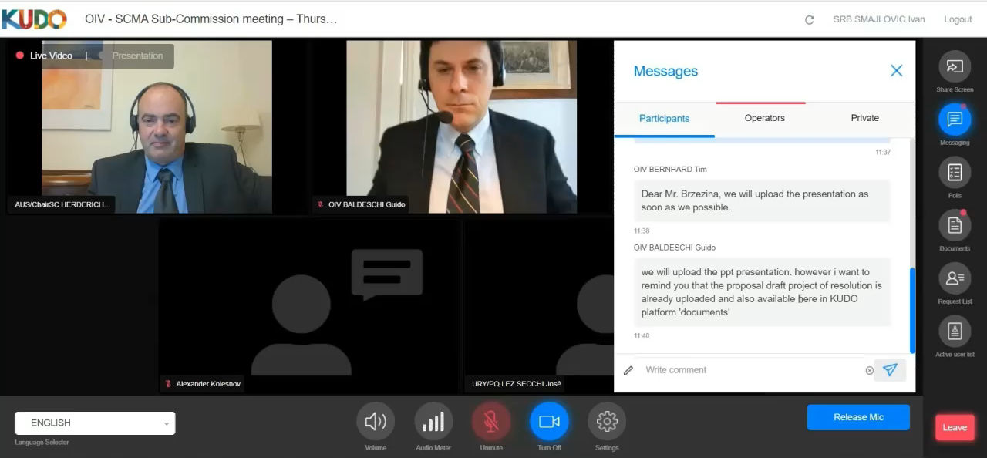
SUB-COMMISSION „METHODS OF ANALYSIS“ – INTERNATIONAL ORGANIZATION FOR VINE AND WINE
Click on the video >>
ANA LAB DOO Proprietary Information,
Powered by ANA LAB DOO Pančevo, Republic of Serbia
www.ana-lab.rs/en/home/

Slide 27
DETECTION OF ILLEGAL WATERING OF GRAPE MUST
ANA LAB DOO Proprietary Information,
Powered by ANA LAB DOO Pančevo, Republic of Serbia
www.ana-lab.rs/en/home/

Slide 28
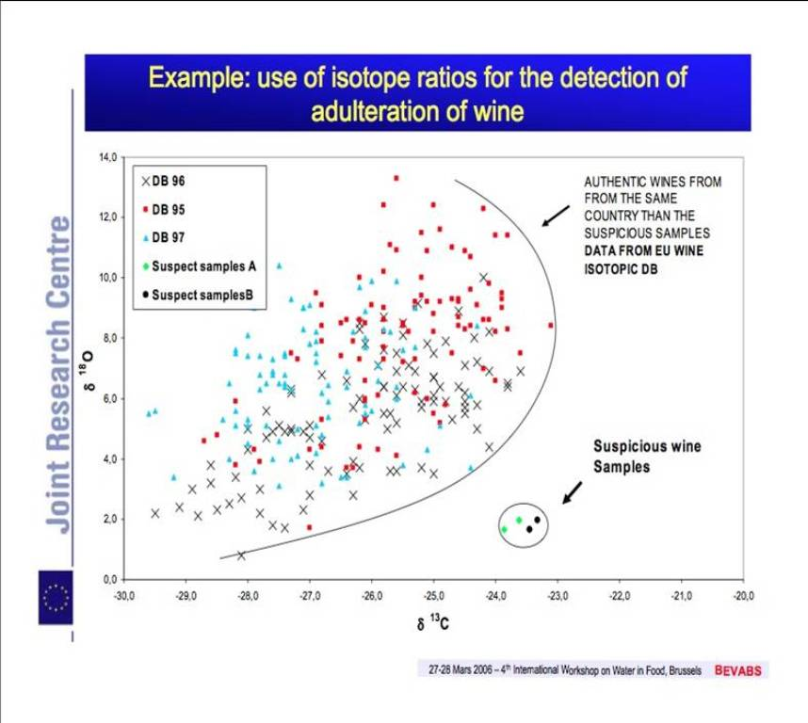
EQUILIBRATION METHOD - IRMS
DETECTION OF ILLEGAL WATER ADDITION TO GRAPE MUST – OFFICIAL METHOD
Currently, water detection is done by analyzing Oxygen isotope via Ewuilibration technique directly from a wine sample.
This method also requires information about an authentic sample from a database in order to determine water addition with confidence.
ANA LAB DOO Proprietary Information,
Powered by ANA LAB DOO Pančevo, Republic of Serbia
www.ana-lab.rs/en/home/

Slide 29
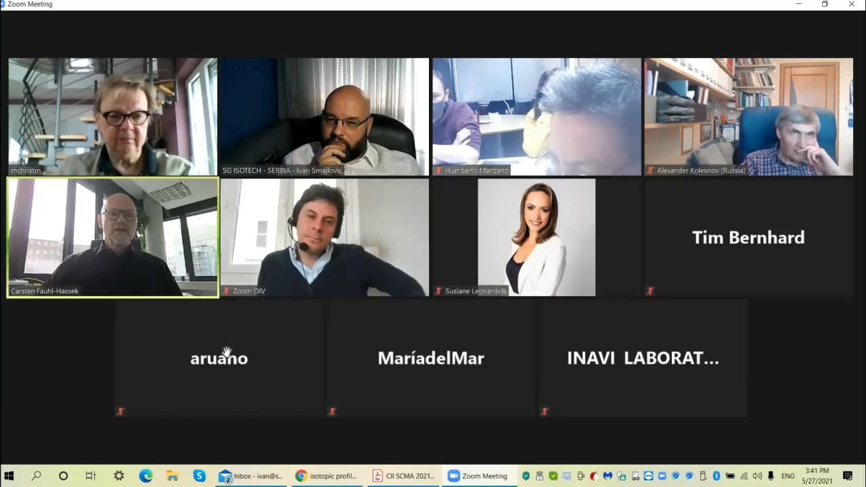
ELECTRONIC WORKING GROUP OF THE OIV SECRETARIAT – WATER ORIGIN DETERMINATION IN WINE
Click on the video >>
ANA LAB DOO Proprietary Information,
Powered by ANA LAB DOO Pančevo, Republic of Serbia
www.ana-lab.rs/en/home/

Slide 30
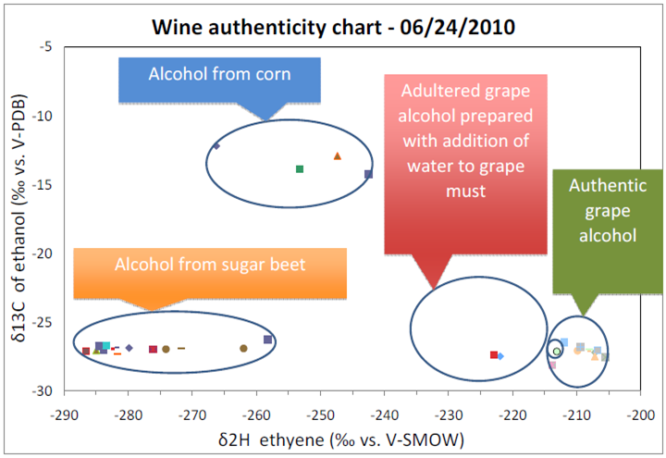
DETECTION OF ILLEGAL WATER ADDITION TO GRAPE MUST WITH EIM-IRMSTM METHOD
For determining addition of water in wine samples EIM-IRMSTM utilizes information obtained from wine ethanol
If water was added prior to alcoholic fermentation wine ethanol δDn_{I} value would be changed
For unknown samples, addition of water will be determined as illegal production practice (addition of water or addition of sugar).
δDn_{I} wine ethanol value (‰ vs. AAWES)
ANA LAB DOO Proprietary Information,
Powered by ANA LAB DOO Pančevo, Republic of Serbia
www.ana-lab.rs/en/home/
Notes:
30

Slide 31
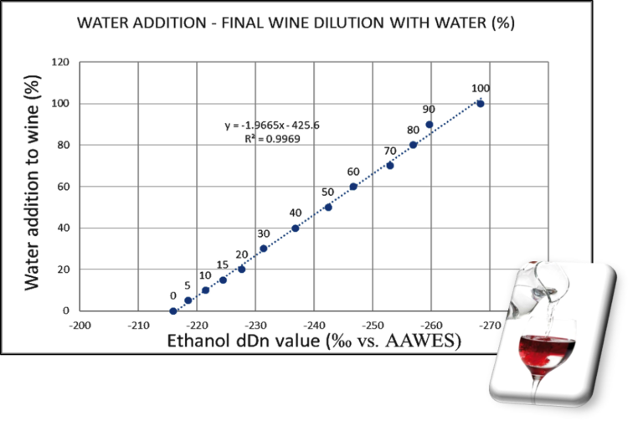
DETECTION OF ILLEGAL WATER ADDITION TO FINAL WINE WITH NEW EIM-IRMSTM METHOD APPLICATION!
For determining addition of water to final wine EIM-IRMSTM utilizes information obtained from ethanol from wine water.
If water was added after alcoholic fermentation ethanol δDn_{II} value would be changed
δDn_{II} wine ethanol value (‰ vs. AAWES)
ANA LAB DOO Proprietary Information,
Powered by ANA LAB DOO Pančevo, Republic of Serbia
www.ana-lab.rs/en/home/

Slide 32
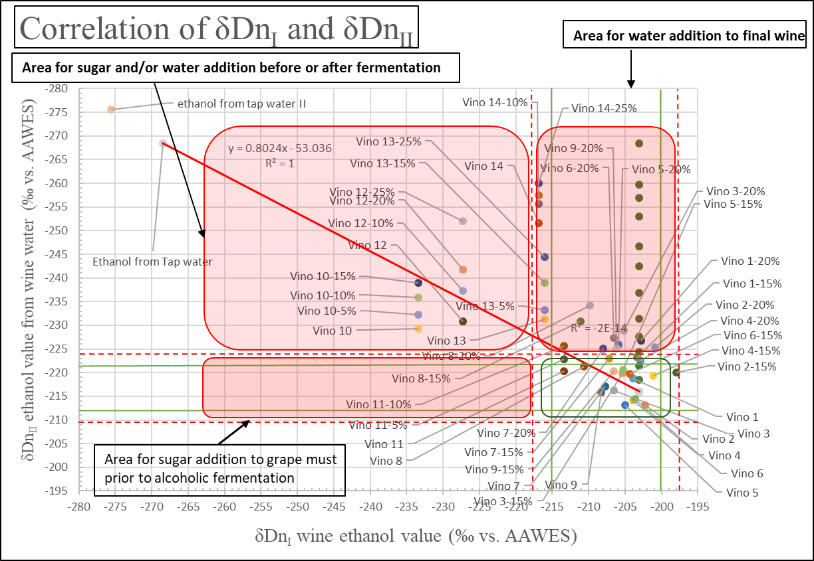
EIM-IRMSTM APPROACH IN DETECTION OF ILLEGAL WINE PRACTICES
Now we can say when, what and how much and how it was added.
If only sugar (beet sugar, potato, wheat, corn, sugar cane, etc.) was added to the grape must prior to alcoholic fermentation, then only wine ethanol δDn_{I} value would be changed and out of the range for grape ethanol δDn_{I} values (Case no.1).
If water or sugar and water was added to the grape must prior to alcoholic fermentation, then both ethanol δD n_{I} & δDn_{II} values would be changed (more negative) and we would get this information too (Case no. 2). Here we can also differentiate how much sugar and how much water was added.
If water was added to the final wine then ethanol δD n_{I} would stay the same but δDn_{II} value would be changed (more negative) and we would get this information too (Case no. 3). Here we can also differentiate how much water was added.
3.
2.
1.
ANA LAB DOO Proprietary Information,
Powered by ANA LAB DOO Pančevo, Republic of Serbia
www.ana-lab.rs/en/home/

Slide 33
GEOGRAPHICAL ORIGIN OF WINE SERBIAN WINE STUDY USING EIM-IRMS CONCEPT
ANA LAB DOO Proprietary Information,
Powered by ANA LAB DOO Pančevo, Republic of Serbia
www.ana-lab.rs/en/home/

Slide 34
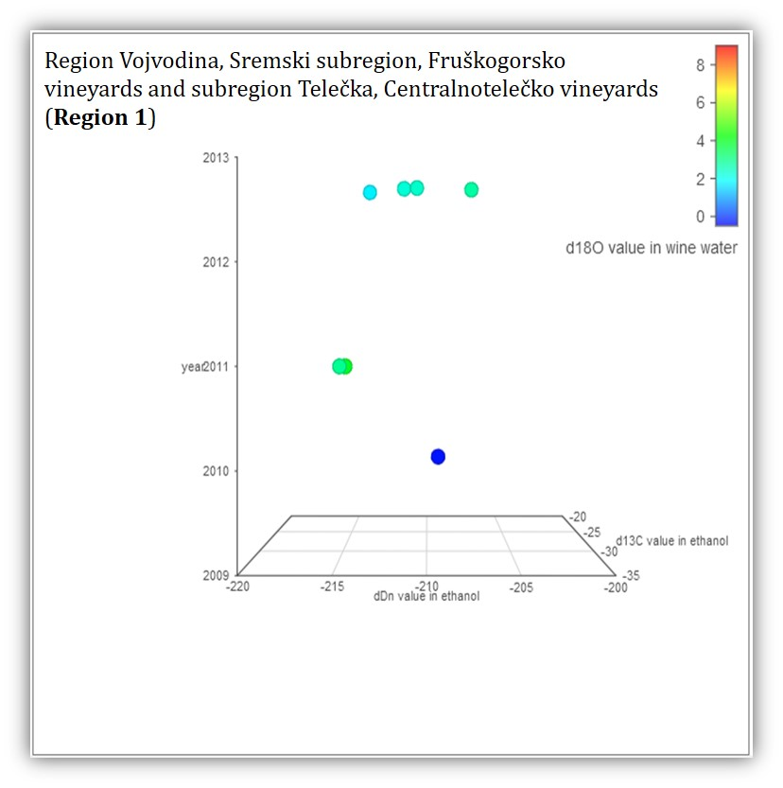
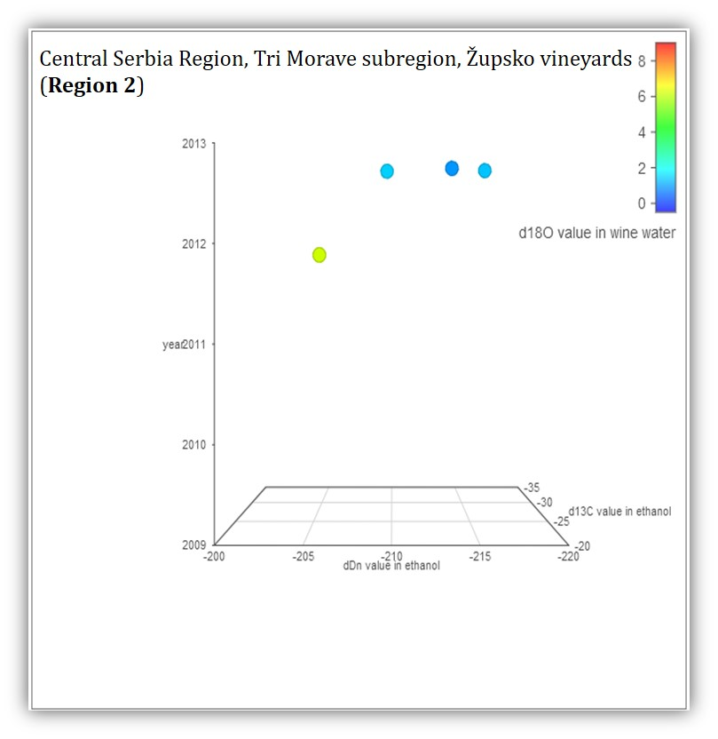
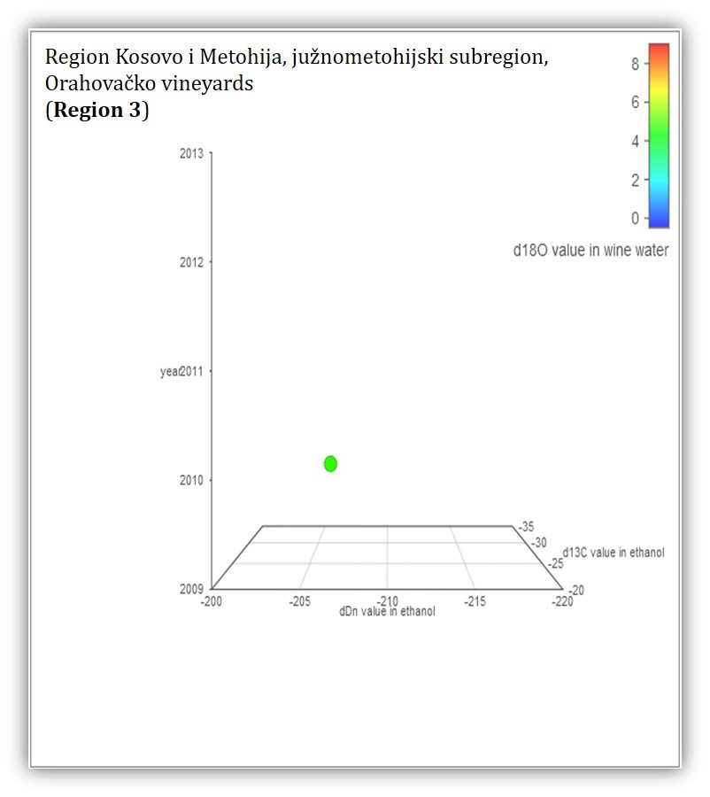
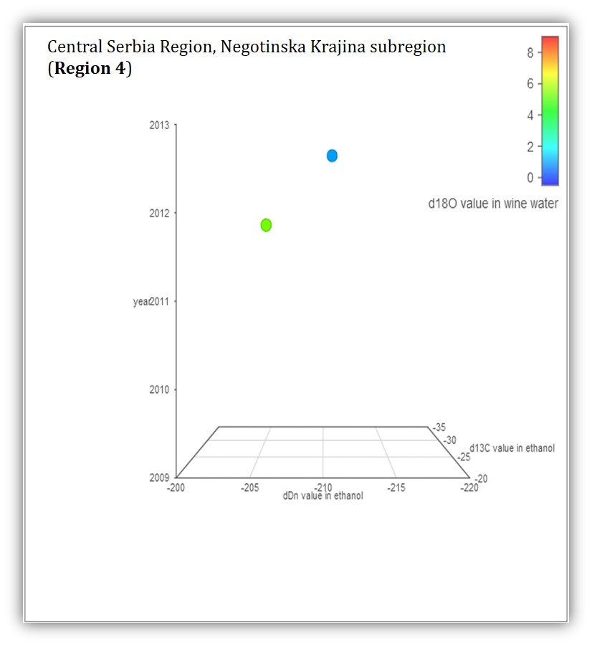
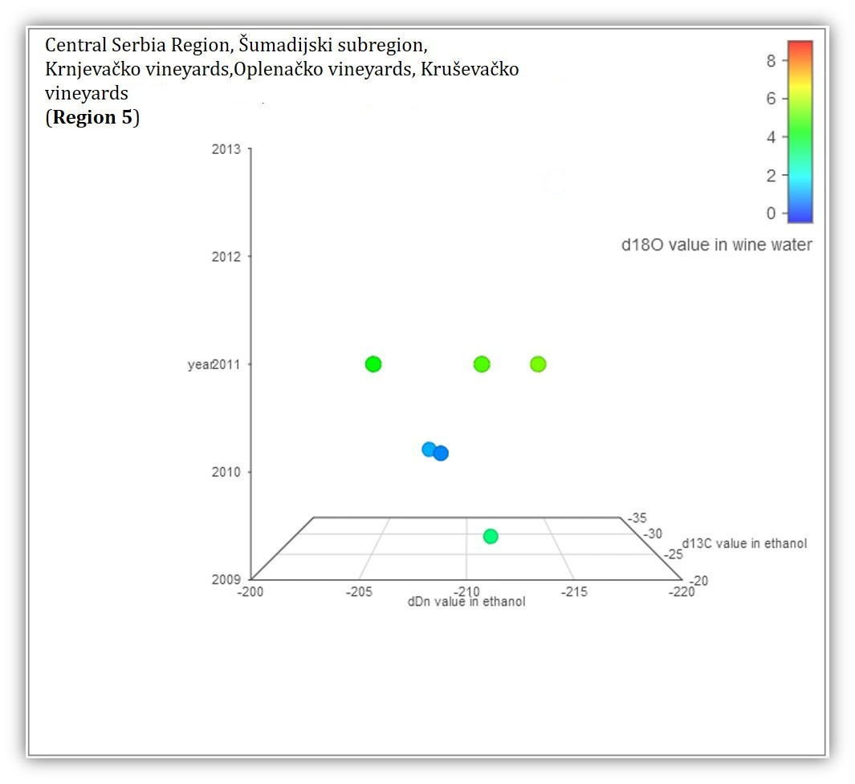
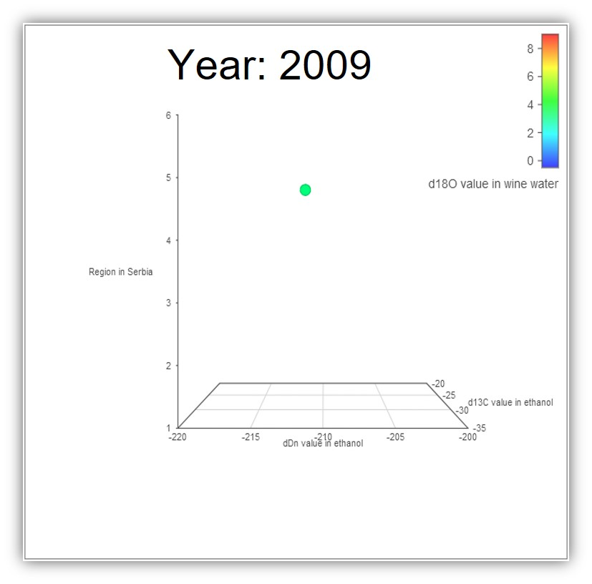
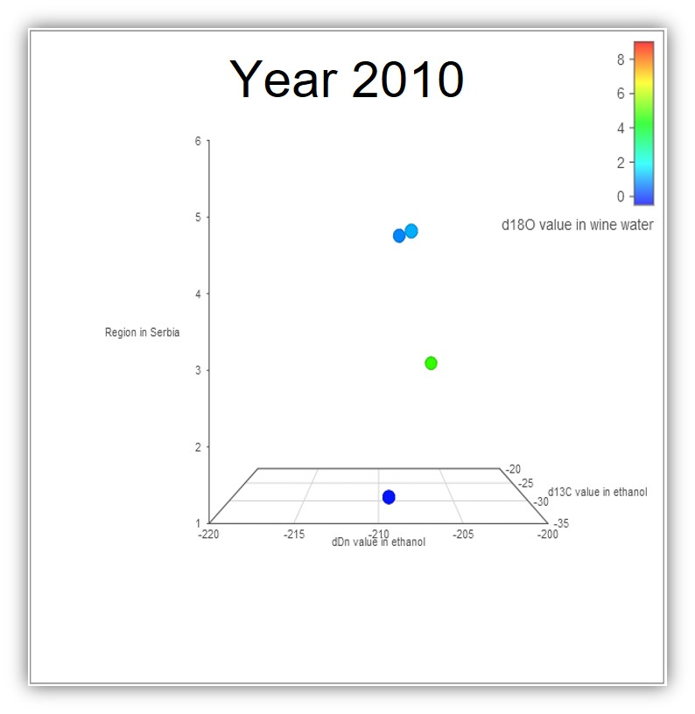
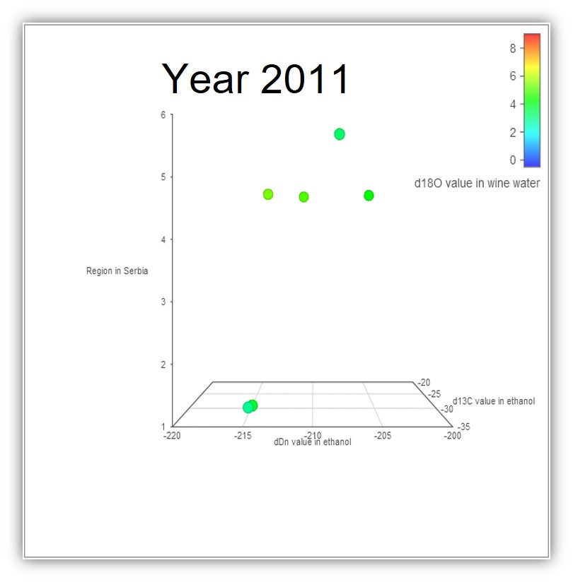
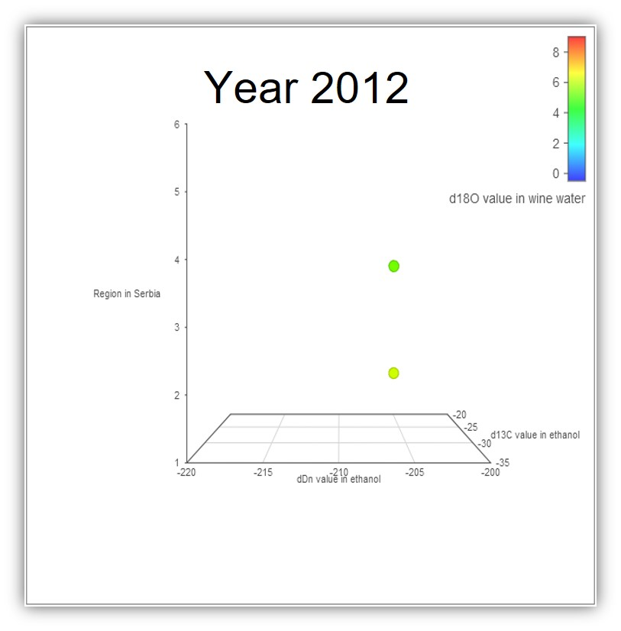
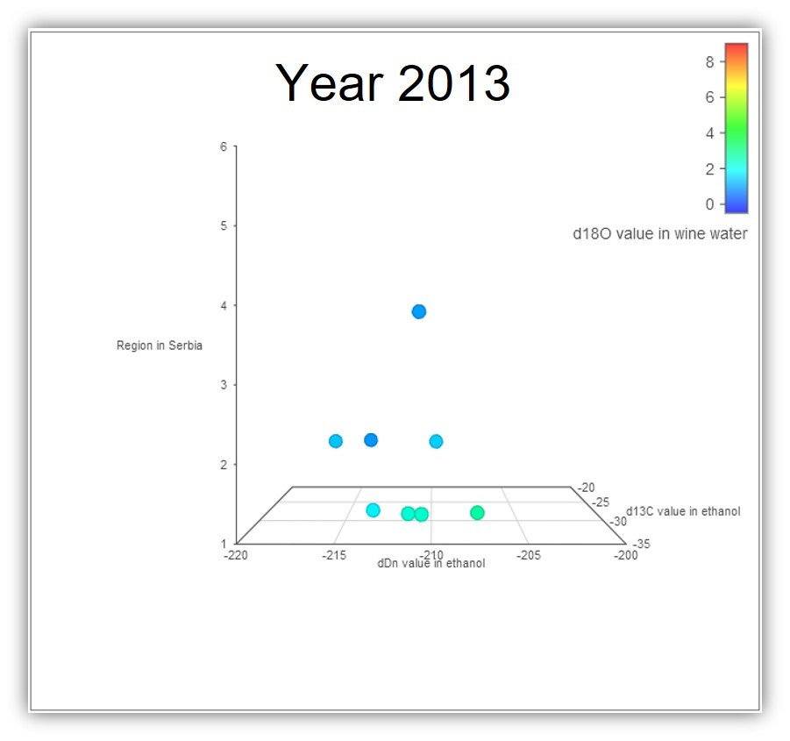
GEOGRAPHICAL ORIGIN OF WINE SERBIAN WINE STUDY USING EIM-IRMSTM CONCEPT
ANA LAB DOO Proprietary Information,
Powered by ANA LAB DOO Pančevo, Republic of Serbia
www.ana-lab.rs/en/home/

Slide 35
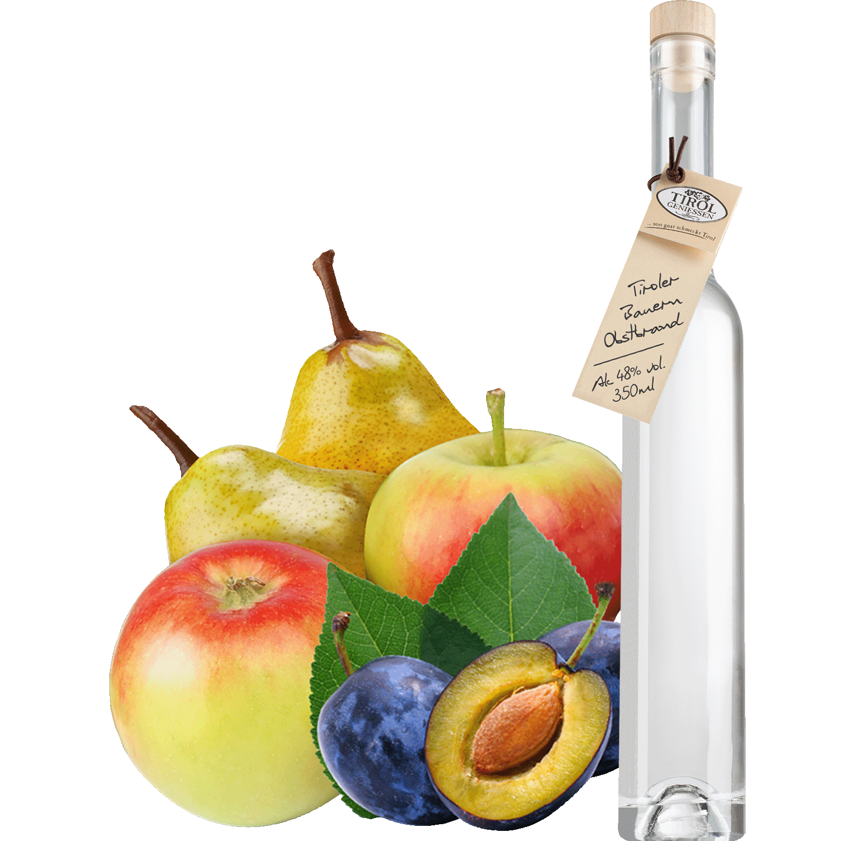
EIM-IRMSTM – FRUIT BRANDIES AND OTHER ALCOHOLIC BEVERAGES AUTHENTICITY TESTING

Slide 36
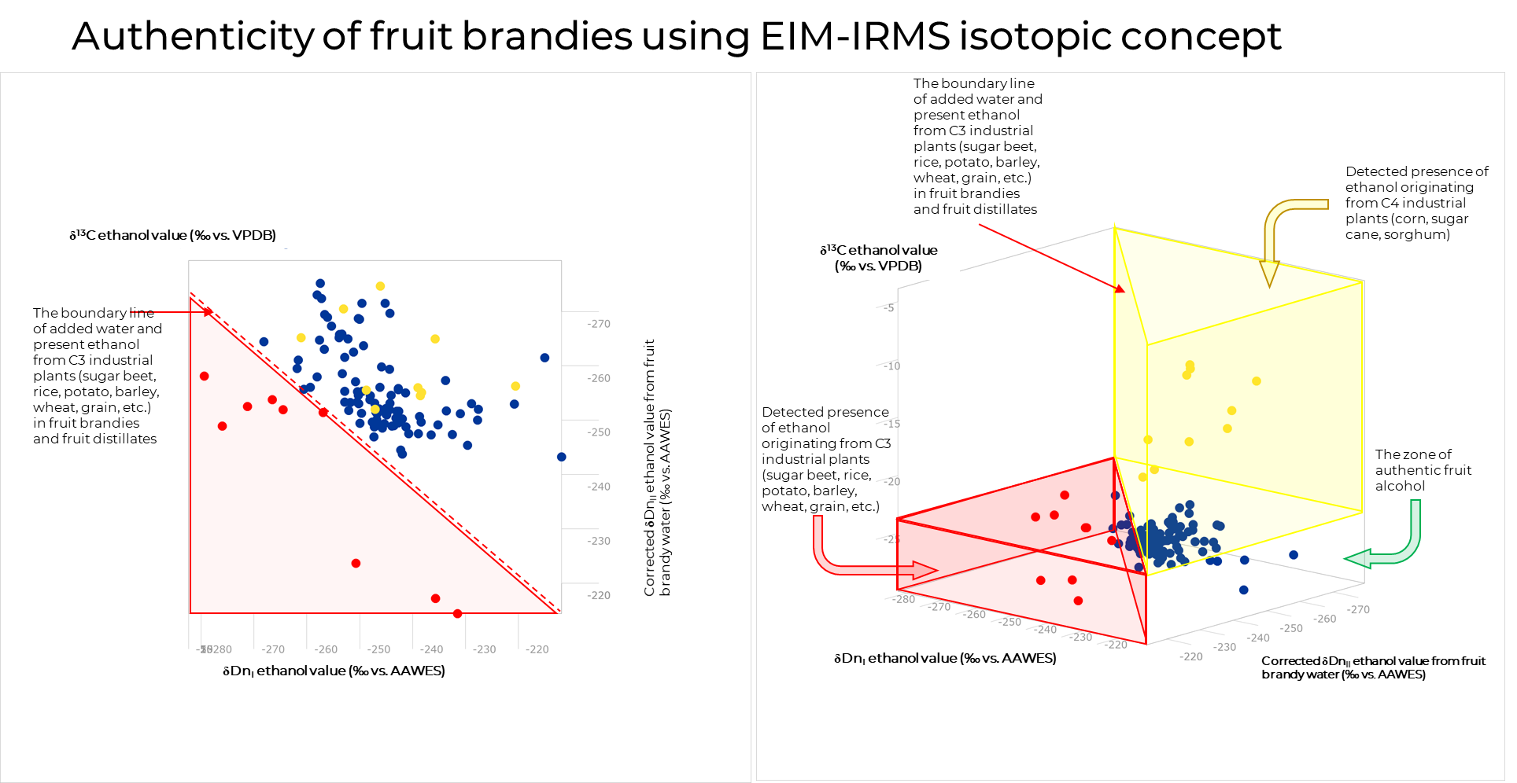
EIM-IRMSTM – FRUIT BRANDIES AND OTHER ALCOHOLIC BEVERAGES AUTHENTICITY TESTING
With EIM-IRMS we can differentiate between added sugar or present ethanol from other botanical origin and added water during the process of making fruit brandies and other alcoholic beverages

Slide 37
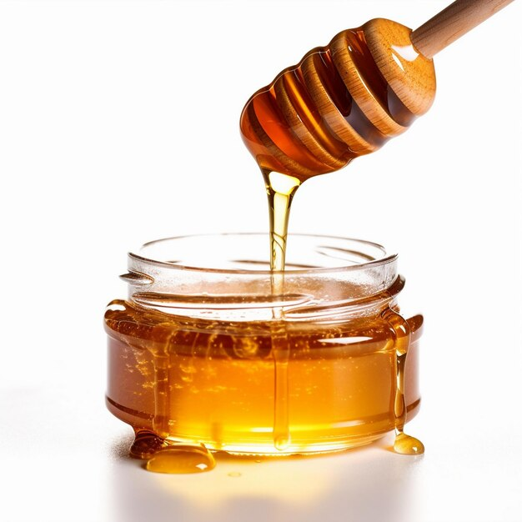
EIM-IRMSTM – HONEY AUTHENTICITY TEST
ANA LAB DOO Proprietary Information,
Powered by ANA LAB DOO Pančevo, Republic of Serbia
www.ana-lab.rs/en/home/

Slide 38
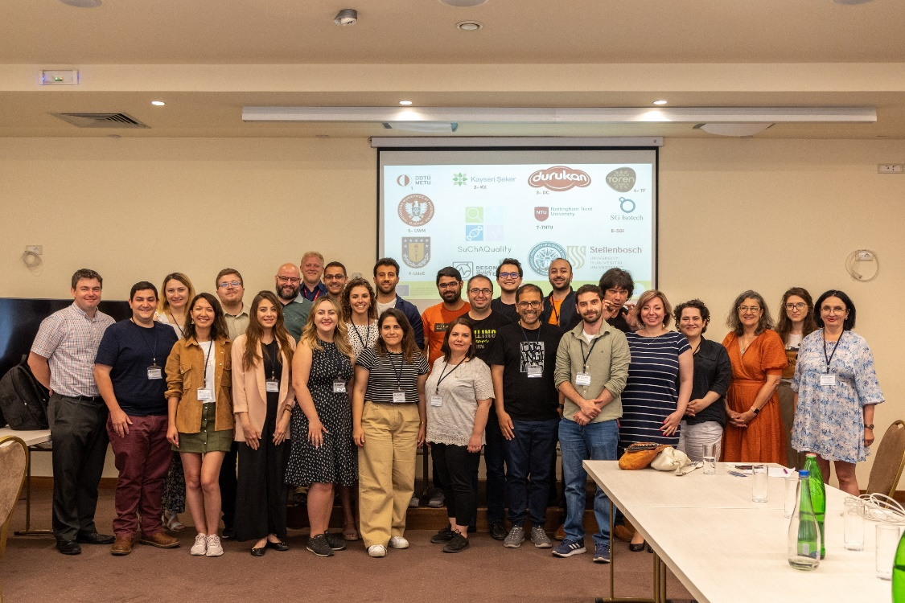
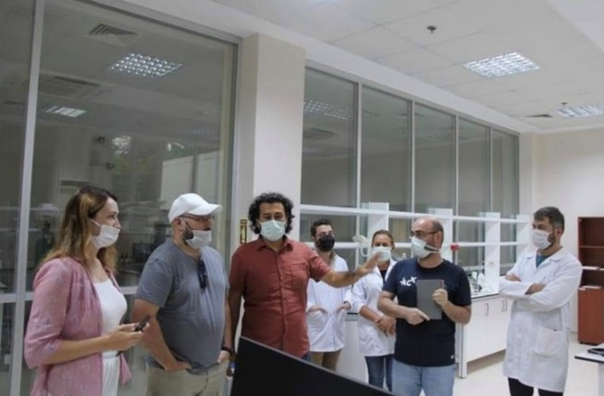
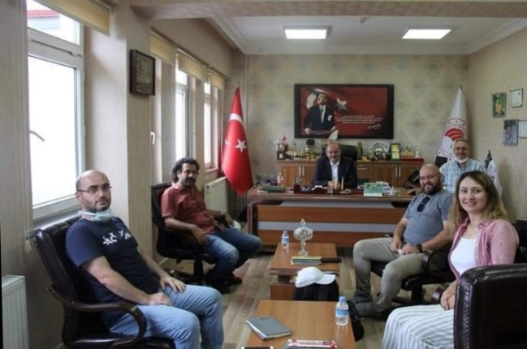
EIM-IRMSTM – HONEY AUTHENTICITY TESTING
The development of the EIM application for honey was made possible by obtaining 2 very important international projects:
SuchAQuality HORIZON Project of the European Commission - Marie Currie Action - a 4-year project worth €1.6 million, which includes expert exchanges with 11 international partners from Turkey, South Africa, Chile, Poland, Pakistan, Germany and Great Britain
TUBITAK 2-year national project of the Turkish Ministry of Science in cooperation with Balmer Apiculture Research Institute from ORDU and METU (Middle East Technical University) from Ankara (Turkey)
ANA LAB DOO Proprietary Information,
Powered by ANA LAB DOO Pančevo, Republic of Serbia
www.ana-lab.rs/en/home/

Slide 39
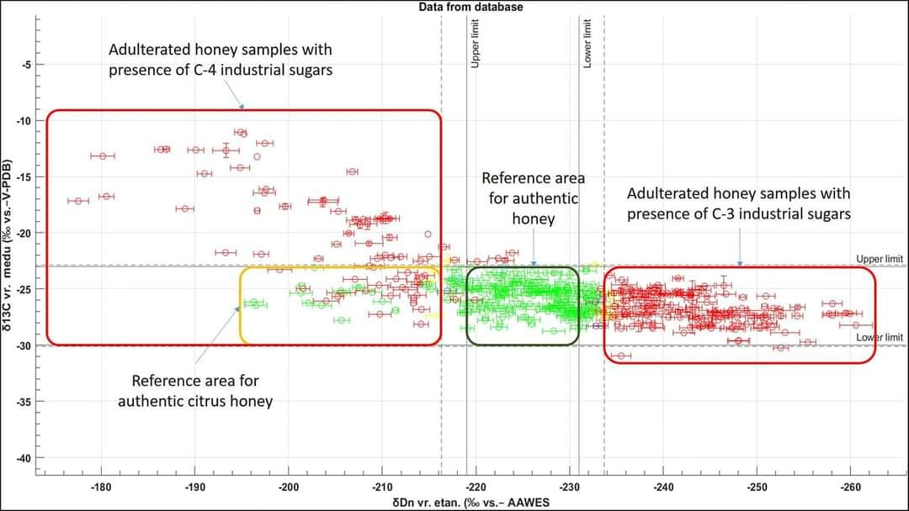
EIM-IRMSTM – HONEY AUTHENTICITY TESTING
SETTING REFERENCE NATURAL RANGES FOR HONEY
During the previous 3 years of the SuchAQuality HORIZON Project of the European Commission, over 1500 honey samples from different parts of the world were analyzed, as well as hundreds of sugar syrups of different botanical origin from C3 and C4 plants from different parts of the world (from Australia, through Pakistan, Europe to Mexico and Chile) and established reference ranges for δDn values of ethanol from fermented honey samples in which authentic honeys will be found.
Complete validations were performed, which included determination of precision (repeatability and reproducibility), accuracy (comparative studies with other methods), linearity, expanded measurement uncertainty.
ANA LAB DOO Proprietary Information,
Powered by ANA LAB DOO Pančevo, Republic of Serbia
www.ana-lab.rs/en/home/

Slide 40
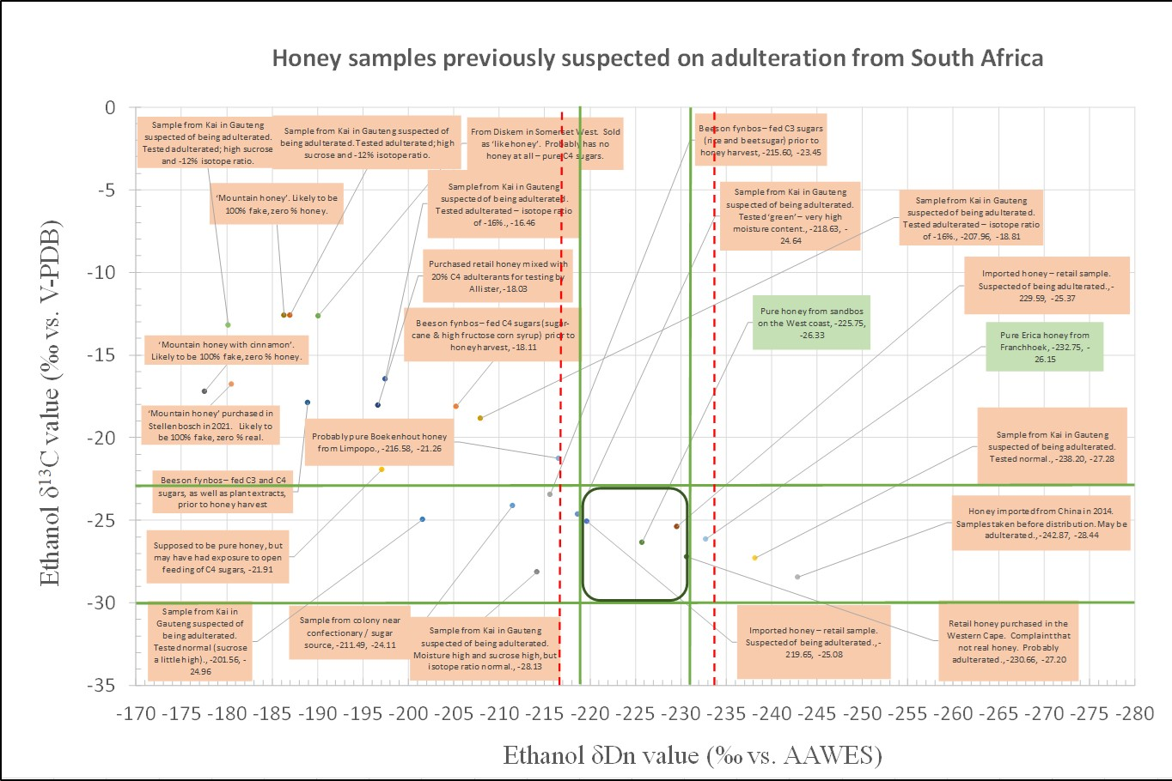


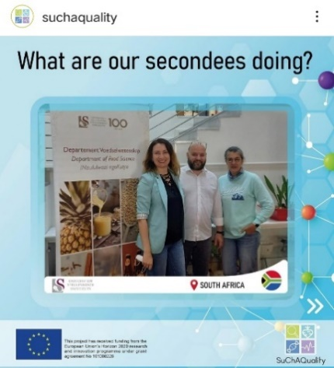
EIM-IRMSTM – HONEY AUTHENTICITY TESTING
MIKE ALLSOPP i PROF MARENA MANLEY - SAMPLES OF FALSE HONEY – REPUBLIC OF SOUTH AFRICA
Also provided was a set of 25 samples from Mike Allsopp of the Agricultural Research Council of South Africa, which were previously suspected and in which fraud had previously been detected based on some other analytical parameters (δ¹³C in honey, HMF, diastasis, increased moisture in honey, LC-HRMS, presence of industrial enzymes, etc.)
Out of 25 samples, 2 samples were authentic. EIM-IRMS confirmed 21 fakes and 2 authentic honeys!
Mike AllSopp, (or Mr. Bee as he is commonly referred to in South Africa)
Honeybee Research Section
Agricultural Research Council of South Africa
ANA LAB DOO Proprietary Information,
Powered by ANA LAB DOO Pančevo, Republic of Serbia
www.ana-lab.rs/en/home/

Slide 41
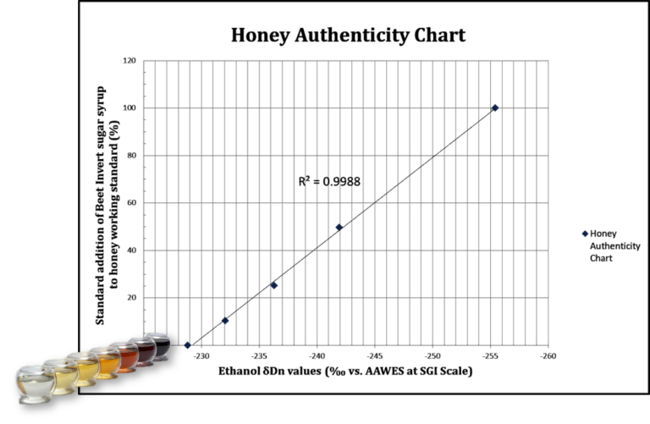
EIM-IRMSTM – HONEY AUTHENTICITY TESTING
DETERMINATION OF LINEARITY - STANDARD ADDITION OF INVERTED SUGAR SYRUP FROM SUGAR BEET TO HONEY
The EIM-IRMSTM method showed incredible linearity to the standard addition of invert sugar syrup from sugar beet and thus became the ONLY METHOD IN THE WORLD WHICH HAS THE POSSIBILITY OF DETECTING THIS SUGAR SYRUP IN HONEY!
ANA LAB DOO Proprietary Information,
Powered by ANA LAB DOO Pančevo, Republic of Serbia
www.ana-lab.rs/en/home/

Slide 42
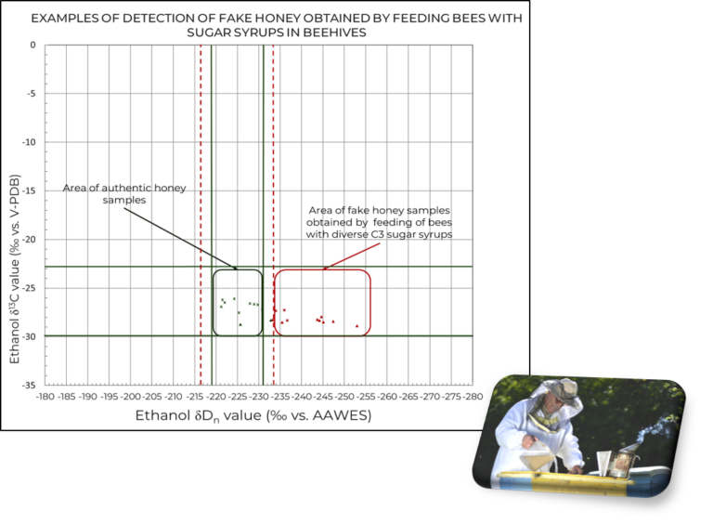


EIM-IRMSTM – HONEY AUTHENTICITY TESTING
DETECTION OF BEE FEEDING - REPUBLIC OF SOUTH AFRICA
As part of the SuchAQuality HORIZON project, a study with bee feeding and detection of bee feeding in South Africa was also done.
Supplementation was added to the bees in the hives at the beginning of the season, while in the second part of the season, after the previous extraction and towards the end of the season (August), collected honey was again extracted, but this time without supplementation. The beehives were arranged in the same location, the honey collected from a group of different types of plants (small bushes) that bloom and produce honey throughout the season under the group name Fynbos.
Mike AllSopp
ANA LAB DOO Proprietary Information,
Powered by ANA LAB DOO Pančevo, Republic of Serbia
www.ana-lab.rs/en/home/

Slide 43
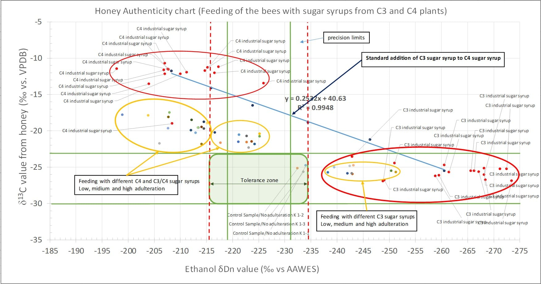
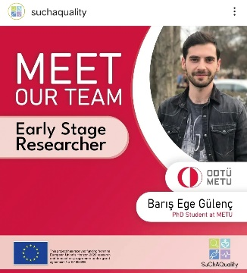

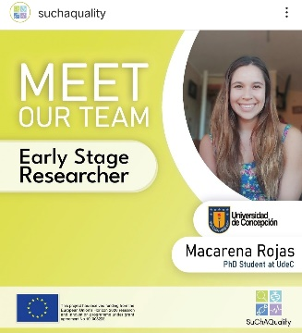
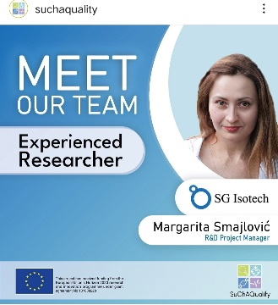
EIM-IRMSTM – HONEY AUTHENTICITY TESTING
TUBITAK PROJECT TURKEY & SuchAQuality HORIZON PROJECT - BEE FEEDING DETECTION - TURKEY
Another study of bee feeding was also carried out as part of the TUBITAK project, which we have with the Turkish Institute from the city of ORDU for honey research and METU from Ankara, Turkey.
Supplementation was done with different types of sugar syrups such as low, medium and high adulteration. EIM-IRMS in correlation with δ¹³C values from honey and honey proteins detected all adulterated honey samples!
ANA LAB DOO Proprietary Information,
Powered by ANA LAB DOO Pančevo, Republic of Serbia
www.ana-lab.rs/en/home/

Slide 44
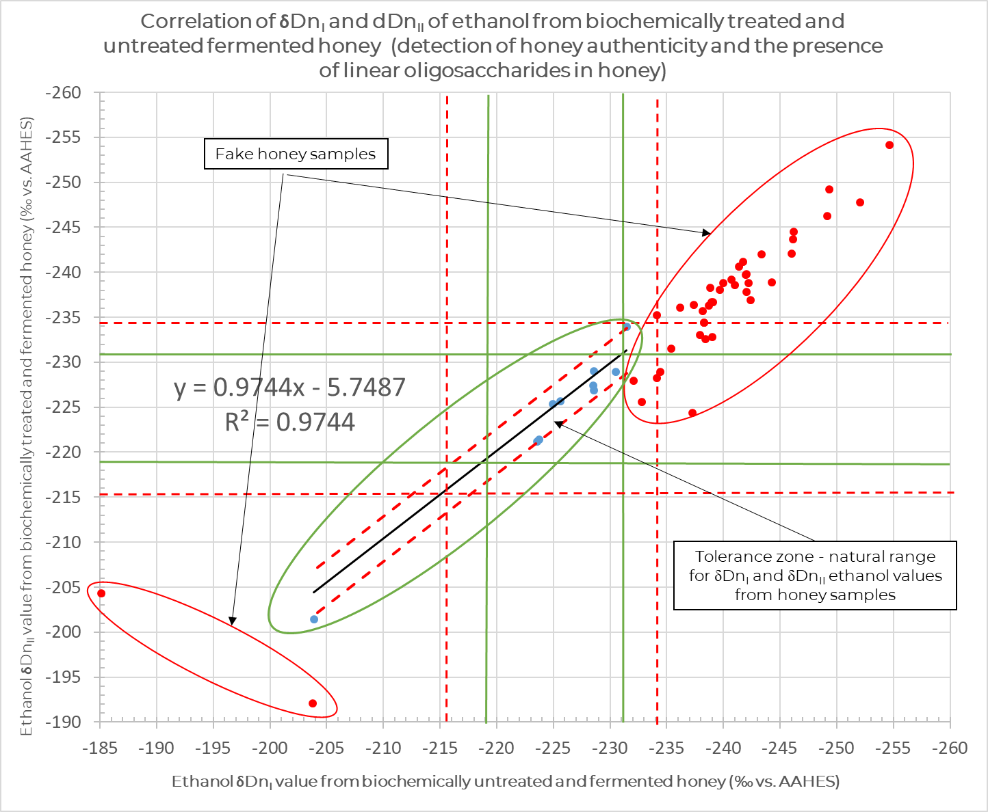
EIM-IRMSTM – HONEY AUTHENTICITY TESTING
DETECTION OF THE PRESENCE OF FOREIGN LINEAR OLIGOSACCHARIDES ORIGINATING FROM STARCHY RAW MATERIALS IN HONEY
The EIM-IRMS method is also able to determine the presence of foreign linear oligosaccharides that are not naturally present in honey.
Linear oligosaccharides are formed as by-products of hydrolysis in the process of producing sugar syrups from starchy raw materials such as corn, wheat, potatoes, barley, rice, grain, etc.
As such, and unlike the natural cyclic oligosaccharides that are naturally present in honey, they are hydrolyzed by enzymes to the final fermentable sugars – glucose, maltose.
By adding enzymes before the beginning of alcoholic fermentation during the preparation of the honey sample, and before alcoholic fermentation, if these higher sugars and ultimate dextrins are present, they will be hydrolyzed and then converted into ethanol. A difference of more than 2.5 ‰ (expanded measurement uncertainty) in the δDn value between an untreated and an enzyme-treated sample will indicate the presence of extraneous linear oligosaccharides in the honey.
ANA LAB DOO Proprietary Information,
Powered by ANA LAB DOO Pančevo, Republic of Serbia
www.ana-lab.rs/en/home/

Slide 45
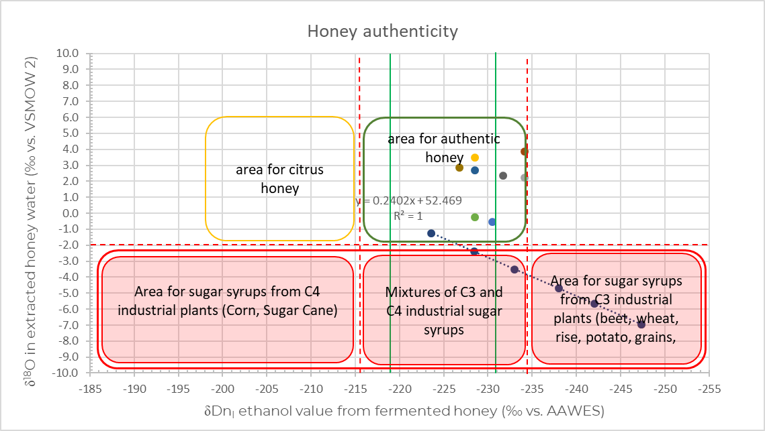
EIM-IRMSTM – HONEY AUTHENTICITY TESTING
CORRELATION δ¹⁸O FROM QUANTITATIVELY SEPARATED WATER FROM HONEY AND δDn_{I} VALUES OF ETHANOL FROM FERMENTED HONEY
Honey contains up to 20 % water. Isotopically speaking, this water does not have the same profile as the water used to make sugar syrups.
In general, waters from all sugar syrups have much more negative δ¹⁸O values compared to real honey.
Correlation of δ¹⁸O from quantitatively separated honey water with δDn_{I} value from ethanol from fermented honey provides additional confirmation of the presence of sugar syrup in honey.
ANA LAB DOO Proprietary Information,
Powered by ANA LAB DOO Pančevo, Republic of Serbia
www.ana-lab.rs/en/home/

Slide 46
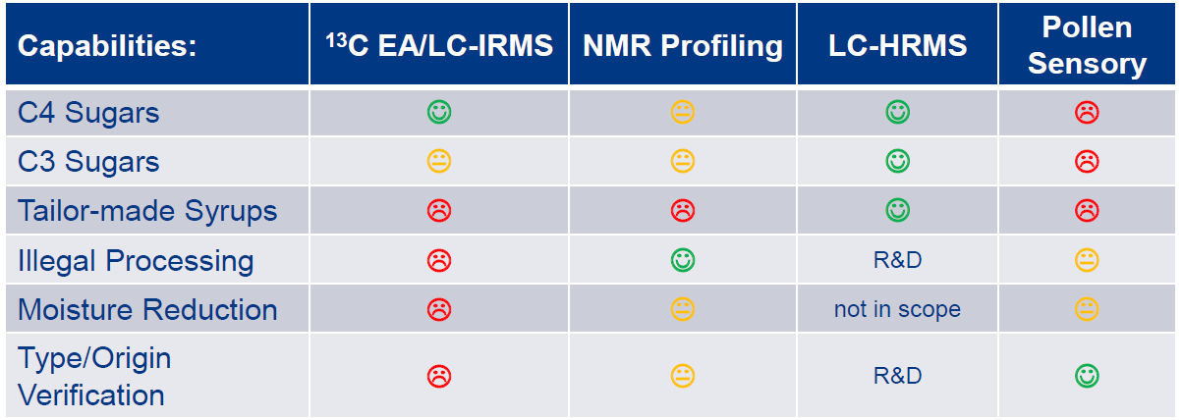
EIM-IRMSTM – HONEY AUTHENTICITY TESTING
METHODS IN THE WORLD USED TO TEST THE AUTHENTICITY OF HONEY
Source: Eurofins GmbH presentation: firewall_Authenticity: Honey_natural_or_articifial
ANA LAB DOO Proprietary Information,
Powered by ANA LAB DOO Pančevo, Republic of Serbia
www.ana-lab.rs/en/home/

Slide 47
EIM-IRMSTM – HONEY AUTHENTICITY TESTING
A COMPARATIVE STUDY BETWEEN EIM-IRMS AND OTHER METHODS FOR TESTING THE AUTHENTICITY OF HONEY FROM 2 GERMAN LABORATORIES
A comparative study was performed on 14 honey samples between the following sets of methods.
1. | NMR profiling | EIM-IRMS
2. | LC-Orbitrap-HRMS
3. | Oligosaccharides in Honey (HPLC-ECD)
4. | 13C-LC-IRMS (C4/C3-sugars), Honey | EA-IRMS (AOAC 998.12)
5. | EA-IRMS (AOAC 998.12)
6. | β-Fructofuranosidase (honey-foreign invertase) Activity (honey-foreign invertase), HPLC-RI | Invertazni broj
Of the 14 comparatively tested honey samples, EIM-IRMS confirmed the authenticity of 11 samples (authentic/not authentic), while the presence of industrial invertase was detected in 3 samples, which was also confirmed by testing the invertase number.
ANA LAB DOO Proprietary Information,
Powered by ANA LAB DOO Pančevo, Republic of Serbia
www.ana-lab.rs/en/home/

Slide 48
EIM-IRMSTM – HONEY AUTHENTICITY TESTING
A COMPARATIVE STUDY BETWEEN EIM-IRMS AND OTHER METHODS FOR TESTING THE AUTHENTICITY OF HONEY FROM A THIRD GERMAN LABORATORY
Another comparative study was done on 6 honey samples between the following sets of methods.
1. | NMR profiling | EIM-IRMS
2. | LC-Orbitrap-HRMS
3. | 13C-LC-IRMS (C4/C3-sugars), Honey | EA-IRMS (AOAC 998.12)
4. | EA-IRMS (AOAC 998.12)
Out of 6 comparatively tested honey samples, EIM-IRMS confirmed the authenticity of the samples (authentic/not authentic).
ANA LAB DOO Proprietary Information,
Powered by ANA LAB DOO Pančevo, Republic of Serbia
www.ana-lab.rs/en/home/

Slide 49
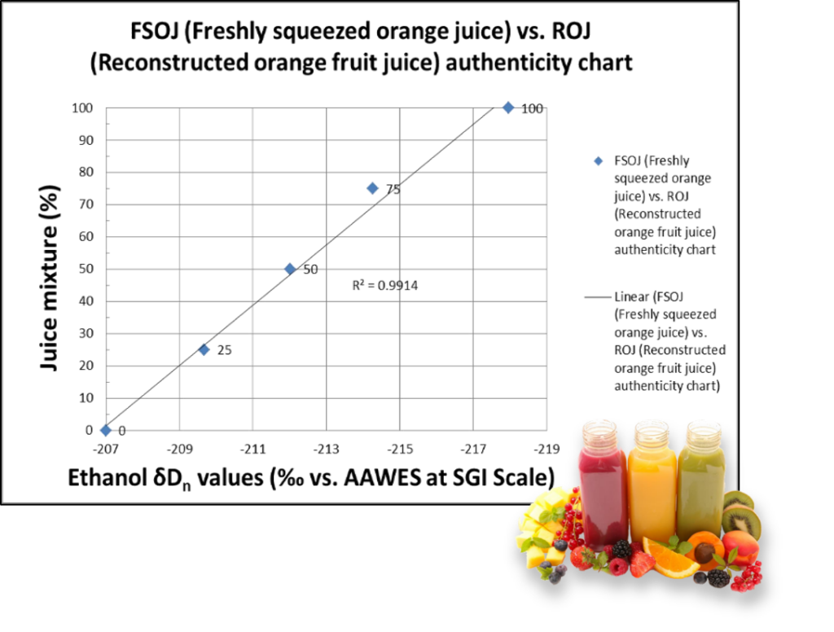
FRUIT JUICES AUTHENTICITY TESTING USING EIM-IRMSTM
EIM-IRMS TM is also capable of differentiating between freshly squeezed fruit juice and reconstructed fruit juice (detection of water origin in fruit juices).
ANA LAB DOO Proprietary Information,
Powered by ANA LAB DOO Pančevo, Republic of Serbia
www.ana-lab.rs/en/home/

Slide 50
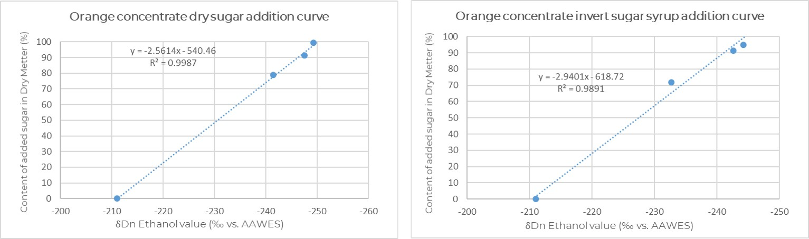
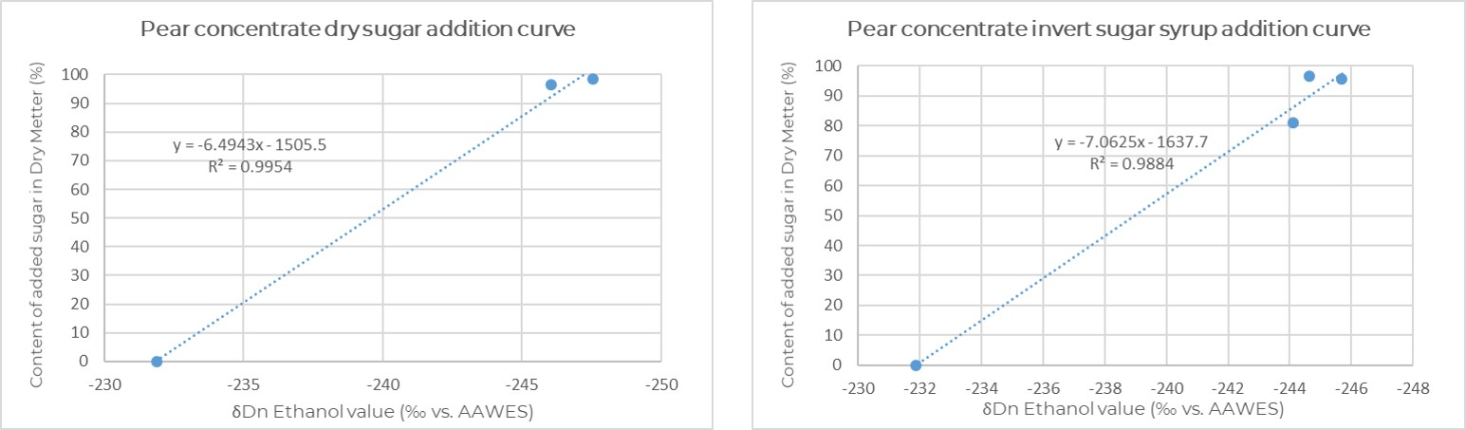
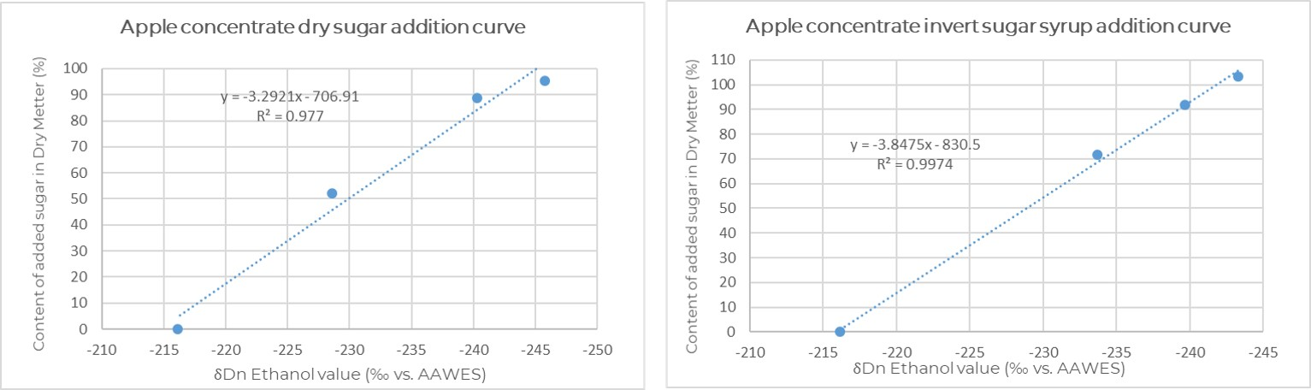
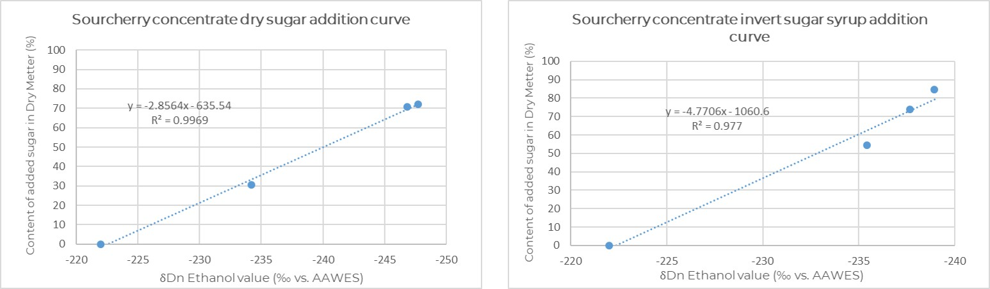
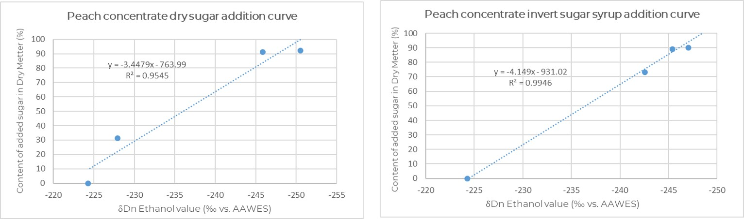
FRUIT CONCENTRATES AUTHENTICITY TESTING USING EIM-IRMSTM
Adding sugar syrup or dry sugar to fruit juices to increase the percentage of dry matter in the process of concentrating fruit juices. In fact, the problem is much more significant. The evaporation process is accelerated by the addition of sugar at the concentration of fruit juice, which is associated with lower energy consumption and shortening of the concentration process. Such a concentrate is then difficult to detect as an illicit practice, whether it has added sugar or originates only from fruit.
In our laboratory, we can detect the presence of added sugar syrups and confirm illegal production, such as the addition of sugar syrups to fruit raw materials (concentrates). This practice is very difficult to detect and can negatively affect all further steps in the production of fruit juices. Producers may not know that foreign suppliers can deceive them and that instead of buying 100% fruit content, they can be deceived into buying counterfeit fruit concentrates. If additives are found in the final products, it would be very difficult to prove that they are not responsible for the fraud.
ANA LAB DOO Proprietary Information,
Powered by ANA LAB DOO Pančevo, Republic of Serbia
www.ana-lab.rs/en/home/

Slide 51
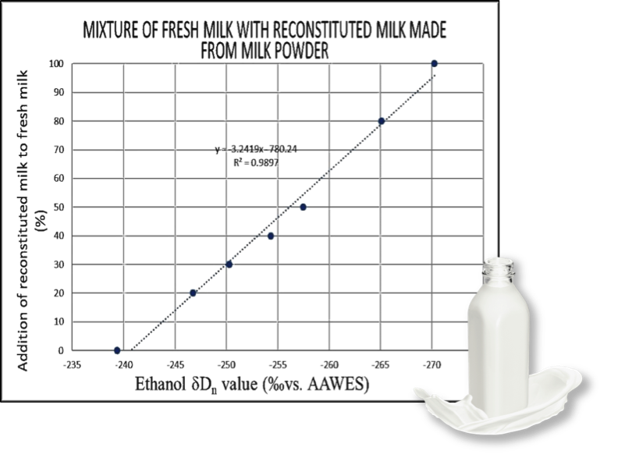
MILK AUTHENTICITY TESTING USING EIM-IRMSTM
We developed unique isotopic method based on EIM tehcnology that is capable to detect illegal adulterations and mislabeling of fresh milk. Since all types of milk adulterations cannot undergo without water addition, now there is a possibility to detect added water to fresh milk. Now, we at ANA LAB have unique possibility to help in detection of illegal production practices in milk production.
Milk testing solution:
⦾Detection of added water to fresh milk
⦾Detection of reconstituted milk supplementation in
fresh milk
⦾Harmonization of the declaration with the product
ANA LAB DOO Proprietary Information,
Powered by ANA LAB DOO Pančevo, Republic of Serbia
www.ana-lab.rs/en/home/

Slide 52
CONCLUSION
  Proven, Published, Accepted and Patented Methods
  Cheaper, much faster, and more accurate
  Able to detect adulteration practices in unknown samples
  Ability to provide fingerprint for strong spirits
  Capable of protecting consumers, producers, distributers, while combating counterfeiting
  EIM-IRMSTM means a single instrument for all isotopic wine analysis
  EIM-IRMSTM saves time and money
  Also applicable outside alcohol industry for testing honey, fruit juices, fruit concentrates, milk, coconut water, maple syrups, fruit products labeled as „without added sugar“, etc.
ANA LAB DOO Proprietary Information,
Powered by ANA LAB DOO Pančevo, Republic of Serbia
www.ana-lab.rs/en/home/

Slide 53
THANK YOU FOR YOUR ATTENTION
E-mails: www.ana-lab.rs; office@ana-lab.rs
Phones: +381132580196 ; +381132580169
Address: Dositeja Obradovica 8k, 26000 Pančevo, Republic of Serbia
ANA LAB DOO Proprietary Information,
Powered by ANA LAB DOO Pančevo, Republic of Serbia
www.ana-lab.rs/en/home/

